Slide 1

Avaya Contact Center Select
Avaya Contact Center Select Customer Presentation 11/24/14

Slide 2





Avaya Midmarket Collaboration Solution
Simple, Powerful & Affordable
Contact Center
Collaboration
Networking
Security

Slide 3




Consumers Are Driving Multichannel Adoption
“I’ll text, IM,
email, or chat.
Please don’t
make me call.”
Voice calls aren’t for everyone
Notes:
The fact is your customers have transformed
In fact, society has changed – we are more aware, more informed, and more connected
And the way we interact has changed – we ARE more mobile, more “social”, and more networked...
Because of that, our businesses must respond and adapt – the traditional ways of managing relationships has changed ... forever
Today’s new “experience management” strategies are being driven by all these forces...
Changes in consumer demographics are rapidly leading to changes in how organizations are engaged - from tablet apps to social media, from video kiosks to instant messaging, the days of the toll free phone number being the dominant entry point into a business are fast fading
Organizations that fail to align their resources to proactively manage these changes can have their sales and service effectiveness rapidly impacted by declining satisfaction. They need to consider – today – how to implement adaptable, flexible, and scalable experience management platforms that provide customers access to resources across communication channels, and that enable end-to-end workflow integration with performance management and business intelligence.
The new success drivers will require real time insight and action; customer care organizations need to anticipate customers choice of how they want to be served and manage the end to end experience; they’ll need to understand the causes of poor customer satisfaction and dynamically adapt in real time, and they have to future-proof their operations & infrastructure for flexibility, to easily adapt to tomorrow’s changing customer expectations.

Slide 4
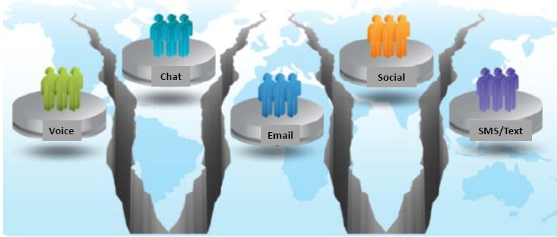
Multichannel Today
Silo’d Multichannel Operations Are Not Effective

Slide 5

Contact Center Challenges
Challenges
Resolution
Customers are wanting to communicate on their terms
Customers often need to repeat themselves once answered
Customers are reporting bad service with agents
Need to increase sales revenue
We don’t know our customers
Losing sales as callers are dropping before we answer
Customers want self-service, online, on the go, and on the phone
Incorporate email, web chat, SMS and fax into the contact center
Eliminate/reduce transfers
Record calls
Make outbound sales calls
Identify customers when they call
Identify and address problem areas
Seamless cross-channel experience and handoff between assisted and automated service

Slide 6




Resolution with Avaya Contact Center Select
Provide Multichannel to your customers
  Include email, web chat, SMS, Fax and voice into your contact center
Implement Skills based routing
  Eliminate transfers and improve customer satisfaction
Use Call recording
  Eliminate conflicts, improve agent/customer interactions,
Enable blending of inbound and outbound calling
  Maximize agent productivity

Slide 7

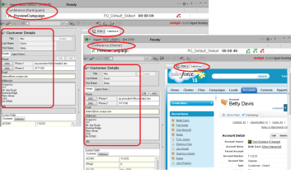

Resolution with Avaya Contact Center Select
Use Agent and Supervisor Desktop
  Integrate to business applications (CRM)
  Screen pop with history, dial from contact
Crucial Comprehensive reports
  React to real time reports and move agents to balance traffic
  Proactively use historical reports to optimize agents, uncover problem areas and balance agents
Integrate to Avaya Experience Portal
  Self service, online, on the go, on the phone
  Speech recognition and text to speech

Slide 8




Avaya Contact Center Select
A Multichannel Contact Center
Customers and Prospect
Contact Center Resources
Voice
Agent
Groups
Universal Queue
Media-specific
Skills-based routing
Agent
Email
External
Destination
SMS
Waiting
Announcements
Web Chat
Call Back
IVR
Fax
Outbound
Dialer

Slide 9

Solving Business Challenges with a
Multichannel Contact Center
Blended Inbound/Outbound Calling | Email | SMS/Chat | Social Media*
Collections Appointment and late payment reminders Special offers | Offload non-critical inquiries to email Templates Keyword routing Auto responses | Push urls Assist with online shopping Product and services support | Automate social response process Best resource matching Promote special offers
Improve Agent Occupancy and Increase Revenues
Provide Fast Responses to Email Inquiries
Increase Sales/Support Efficiency
Boost Customer Satisfaction
* Planned roadmap for Avaya Contact Center Select – subject to change

Slide 10





Routing and Resource Prioritization
Route calls to the most appropriate resource or agent
  Eliminate transfers
  Improved customer experience
Dynamic agent standby if service levels fall
Up to 1500 skills
Up to 150 skills per agent
  Set priority 1-48
Best agent to handle call
Routing based on:
Dialed Number
IVR
Calling number
History
Backup agent to handle call
Backup agents or alternative

Slide 11




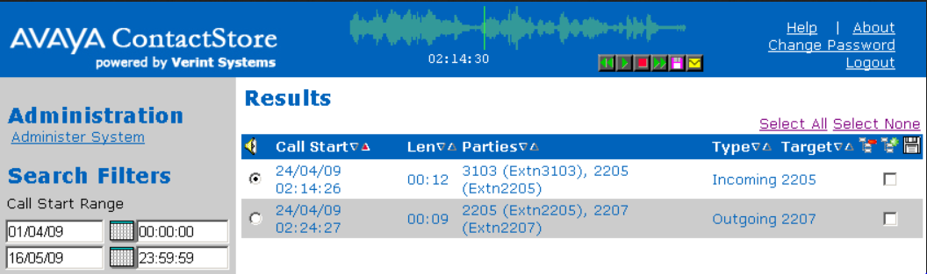
Call Recording
Better train agents and eliminate conflicts
Record agent Inbound/outbound calls
  Sampling
  Every call
Easily search for recorded calls by agent, CLI, dialed number…..

Slide 12



Blended Inbound/Outbound Dialing
Increase sales revenue
  Advertising campaigns
  Upsell opportunities, post sale
Improved agent efficiency
  Agents logged in to inbound/outbound
  Automatically start outbound on reduced inbound traffic
Better prepared agents before ‘connect’
  ‘Preview’ customer information
  Defined Agent scripts

Slide 13

Agent and Supervisor Desktop
Full multi-channel management
Consistent Handling of multiple contacts
Sharing of Customer Details, Screenpops on transfer
Reason/disposition codes
Full supervisor management
  Force agent state – with reasons
  Realtime
      History of all contacts types
      Screen pops
Presence
Real-time statistics
Full session control
Call back missed calls!

Slide 14
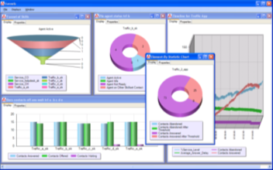
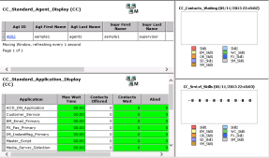
Comprehensive Reports
“You can’t manage what you can’t (or don’t) measure!”
High impact, Fully customizable web based management and administration
Full control over agents, channels and groups
Historical and real time reports – all channels
  Export to PDF, Excel, CSV
  Automatic and Manual
  ‘Canned’ templates
  Fully customizable

Slide 15
Agent and Supervisor Desktop
Full multi-channel management
Consistent Handling of multiple contacts
Sharing of Customer Details, Screenpops on transfer
Reason/disposition codes
Full supervisor management
  Force agent state – with reasons
  Realtime
      History of all contacts types
      Screen pops
Presence
Real-time statistics
Full session control
Call back missed calls!

Slide 16
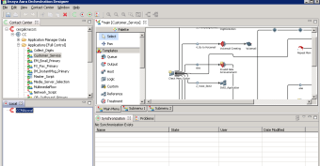
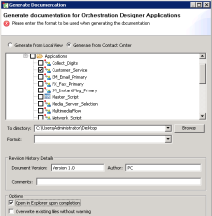
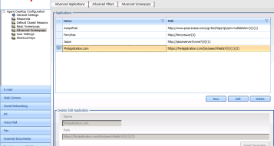
Avaya Contact Center Select
Intuitive and Powerful Administration
Graphical ‘flowchart’ defines workflow for all channels
Predefined templates
  Accelerate and simplify introduction
Simple screen ‘pops’
  Launch new browser/new tab in desktop
  Integrate to external application
Provide comprehensive self service with Avaya Experience Portal
  Add speech recognition and text to speech as an option

Slide 17





Avaya Midmarket Collaboration Solution
Simple, Powerful & Affordable
Contact Center
Collaboration
Multichannel
Skills based routing
Call recording and reporting
Room, desktop, mobile
Supports 3rd party devices
Simple, affordable
Broadest endpoint support
Most flexible deployments
Rich UC feature set
Unified Communications
Conference control
User presence
WiFi/3G/4G connectivity
Mobility
Security
Networking
Protects SIP trunks
Secures remote endpoints
Active packet inspection
Automated provisioning
Rich feature set
50% lower TCO

